Slide 1
Viruses

Slide 2
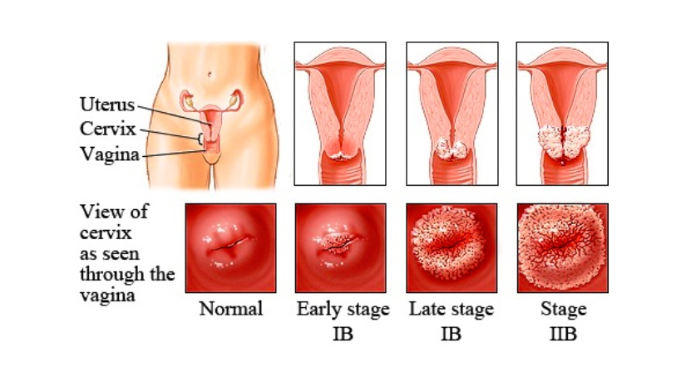
HPV
Infects the cutaneous epithelium.
Most commonly sexually transmitted infection in the U. S.Occurs throughout the world.
Papollomavirus Humans only natural reservoir
•Host Range:
Cervical Cancer anogenital warts
–recurrent respiratory
–papillomatosis
–cervical cancer precursors (cervical intraepithelial neoplasia)
–cancer (cervical, anal, vaginal, vulvar, penile, and oropharyngeal cancer)
Direct sexual contact (including non penetrative sex) with infected person

Slide 3
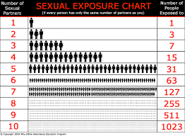
HPV

Slide 4
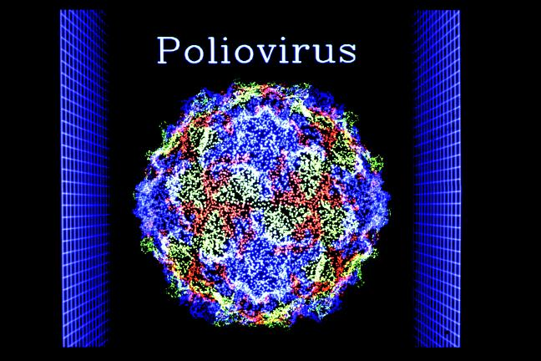
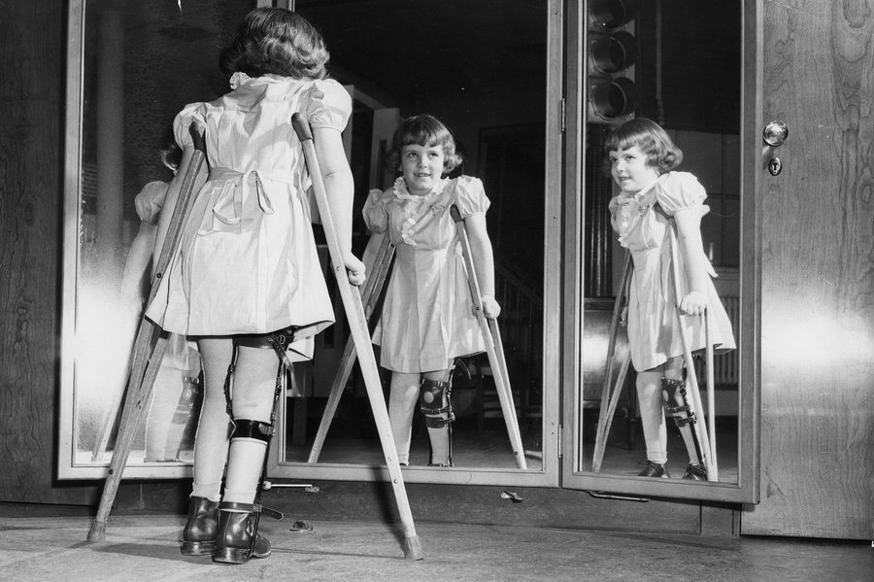
Polio
Poliovirus is a member of the enterovirus subgroup, family Picornaviridae.
-Enteroviruses are transient inhabitants of the gastrointestinal tract,
-stable at acid pH.
-Picornaviruses are small, ether-insensitive viruses with an RNA genome.
First Outbreaks reported in Europe 1700s
-A polio eradication program conducted by the Pan American Health Organization led to elimination of polio in the Western Hemisphere in 1991.
Humans only reservoir host
Disease of the Central Nervous System causing paralysis
Infectious dose
-Persons infected with poliovirus are most infectious from 7 to 10 days before and after the onset of symptoms, but poliovirus may be present in the stool from 3 to 6 weeks.
.

Slide 5
Influenza
Originally found among birds and other animals such as pigs.
Can be found all over the world
There are 4 different strains, so they don’t spread the same way.
The H3N2 virus originated in East and SouthEast Asia, then proceeded to spread around the world.
Transmission:
Close contact (holding hands, not washing hands before eating or touching mouth or other parts of face, touching surfaces, shaking hands, etc)
4 strains of the flu
Same symptoms, different speed of transmission.
H3N2 spreads around more quickly than H1N1 and B strains
Notes:
• Influenza A-
• Ducks
• Chickens
• Pigs
• Whales
• Horses
• Seals
• Cats
• Influenza B
• Only among Humans
• Divided into two subtypes:
Hemagglutinin (H)- 18 different subtypes
Hemagglutinin is one of the reasons that influenza virus is so effective. It is a spike-shaped protein that extends from the surface of the virus. (Reason why the flu can bind so well)
Neuraminidas (N)- 11 different subtypes
Neuraminidase is a constituent of the enveloping membrane that surrounds the viral contents.
Transmission.
• H3N2 Mutates rapidly causing a key protein on the outside that helps attack the immune system of humans causing humans to be susceptible to the flu every year and why there is a new vaccine every year.
• The strain mutates quickly so it is able to spread around the world quickly as well.
• H1N1 and B viruses affect more children than adults. These strands don’t spread due to the fact that children don’t travel as much as adults do.

Slide 6
Influenza
Host Range:
24-48 hrs
Flu will come in contact with respiratory tract, and will make its way into the cells and start replicating. No symptoms are present at this time.
The next 5-7 days
The immune cells are activated and moved to locations where the virus is replicating and will alert the body to jump start the immune system into gear.
Last 24-48 hrs
Inflammation finally decreases, and some of the lingering fatigue or sore t hroat may still be present.
Notes:
People most at risk to get the flu would be:
Doctors, daycare workers, teachers, anyone that works with kids, or around infected people.

Slide 7
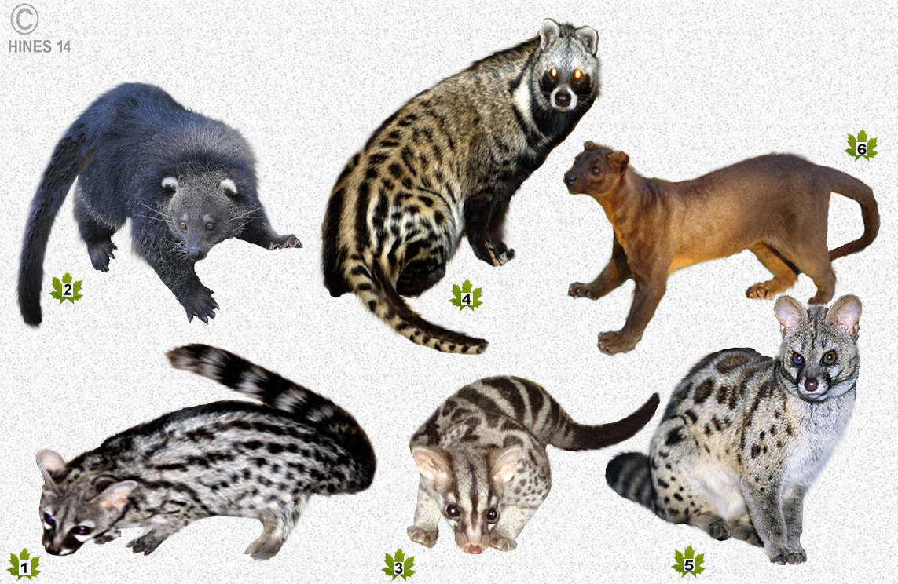
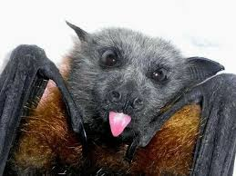
SARS
Natural Host:
  Found in bats and civets
It is found in soil around the old chicken houses, starling birds roosts, and bat caves.
Host range:
  A progressive form of the disease generally occurs in the young and elderly, as well as anyone with immune deficiency
    Symptoms shows after 10 days of exposure
      Exposure to the fungus includes fever 100.4°F (38.0°C), headache, other breathing symptoms, muscle aches, and cough.
      It first attacks the alveolar macrophages in the lungs, then they disperse in the blood and lymph
      More frequently found in adult males
Mode of transmission:
  Respiratory droplets produced when an infected person coughs and sneezes
  It can also spread when a person touches a surface or object contaminated with infectious droplets and then touches his/hers mouth, nose, or eyes.
  May live on hands tissues and other surfaces for up to 6 hours in these droplets and up to 3 hours after the droplets have dried.

Slide 8
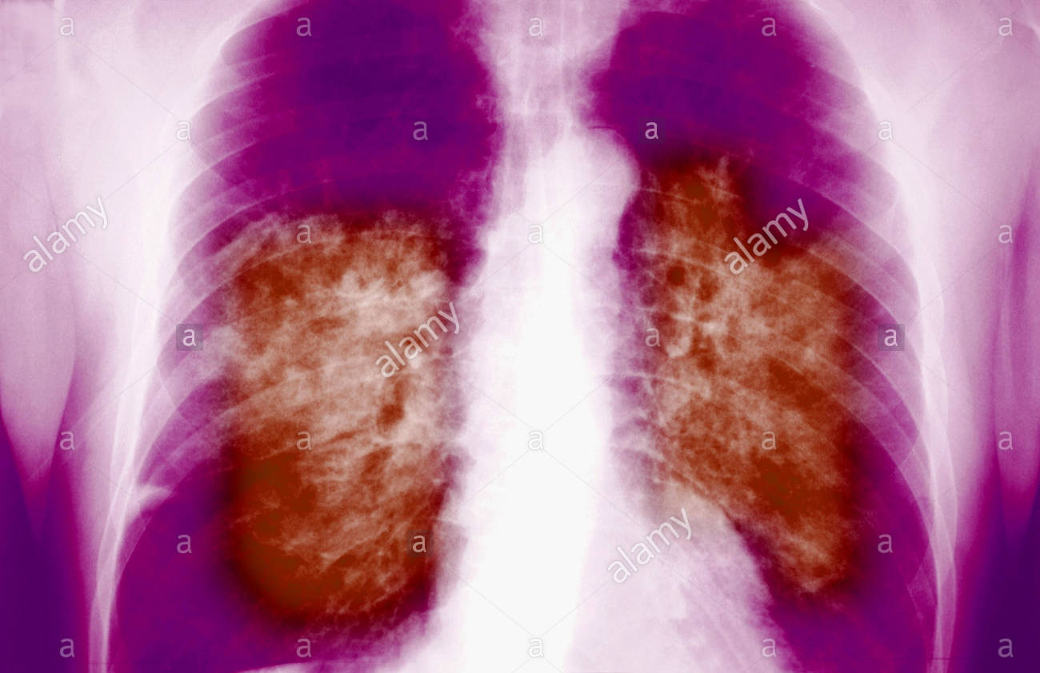
SARS
Predisposing and occupational risks
  If exposed, you should be vigilant for the development of symptoms
  Be actively monitored
Disease:
  Is caused by a member of the coronavirus family of viruses
  Live viruses had also been found in stool of people with SARS, and can live up to 4 days.
  The virus can live for months or years when the temperature is below freezing
Infectious dose:
  Treatments that may help but is not known how well they might work may include:
    Antibiotics to treat bacteria that causes pneumonia
    Antiviral medicines
    High doses of steroids to reduce swelling in the lungs
    Oxygen breathing support or chest therapy
  Natural infection in human cases would result from exposure to a lower virus dose
    Touching or being around contaminated areas
    Consuming an animal that has the virus

Slide 9
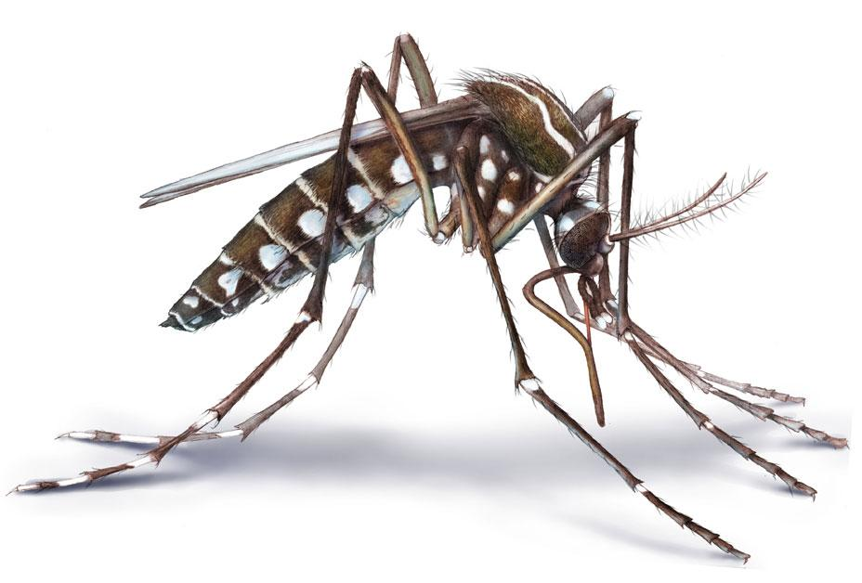
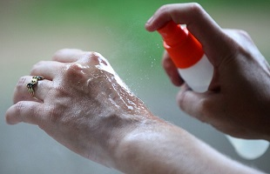
Zika Virus
Zika belongs to flaviviruses. It’s similar to other flaviviruses such as dengue, yellow fever, and West Nile virus
It was first isolated from a monkey in the Zika forest of Uganda in 1947, and the first human case was reported in 1954.
Hosts and Transmission: Can be transmitted from Aedes mosquito to humans or sexually transmitted. Also a pregnant woman who contracts Zika may transmit the virus to her baby.
Those at risk: Pregnant women and the fetus (transmitted from the mother) have the most to lose from infection. Zika is prevalent in Central and South America, Central Africa, and South Eastern Asia. Elevations below 6,500 feet are habitable by the mosquito carrier.
Symptoms: Only 1 in 5 people infected with Zika will get symptoms. Microcephaly in fetuses; headaches, conjunctivitis, rashes, muscle pain, joint pain in adults
Diagnosis: Virus present in urine and blood.
Treatment: No effective antiviral medication, symptoms should be treated directly. There’s no vaccine either.

Slide 10
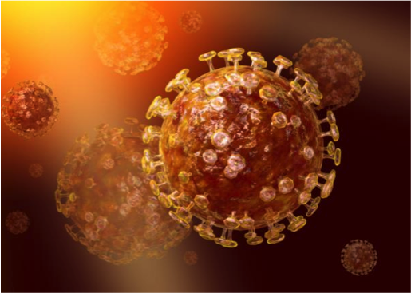
Middle Eastern Respiratory Virus (MERS)
● MERS and SARS (severe acute respiratory syndrome)
○belong to the same family of viruses, called coronaviruses
○cause diseases ranging from the common cold
●MERS-CoV may have originated in bats and was transmitted to camels in the distant past.
○cattle, sheep, goats and various other camelid species
● Middle East, particularly in Saudi Arabia around the Arabian Peninsula.

Slide 11
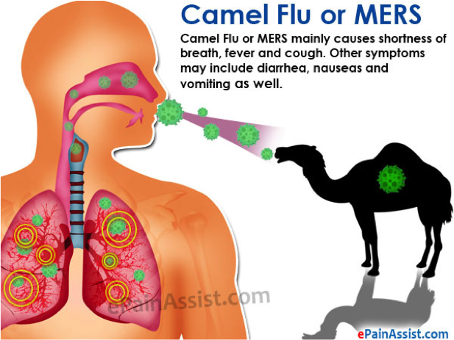
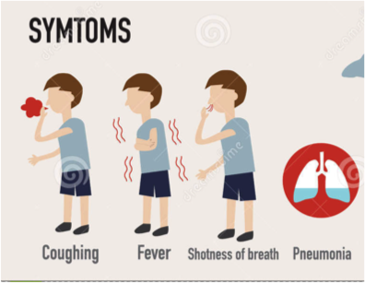
Middle Eastern Respiratory Virus (MERS
●Causes infection of the lungs and affects breathing
○may also cause damage to the kidneys and other organs
●Spreads from an infected person’s respiratory secretions, such as through coughing.
○caring for or living with an infected person
○healthcare settings, such as hospitals.
●Severe to people with:
○ weakened immune systems, older people, and people with chronic diseases
■renal disease, diabetes, cancer, and chronic lung disease
○Severe cases can include respiratory failure that requires mechanical ventilation and support in an intensive-care unit.
●Upon a combination of intratracheal, ocular, oral, and intranasal inoculation with 7 × 10(6) 50% tissue culture infectious dose of the MERS-CoV isolate

Slide 12
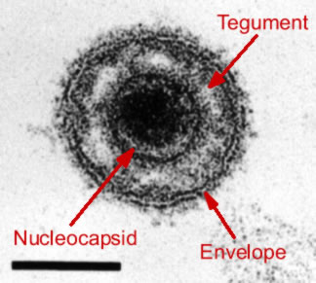
Herpes family of viruses
Hosts: Herpes has been discovered in a wide range of animals
Pathogenic species: herpes simplex 1 (usually oral) and 2 (usually genital), Varicella-zoster virus (chickenpox)
Those at risk: Babies in the womb or birth, those who are sexually active with multiple partners (contact with mucosal epithelial cells causes transmission)
Symptoms: Ulcers near the genitals, cold sores near the mouth
Diagnosis: PCR is taken from viral genome, the virus can be isolated in cell cultures, ELISA to test viral antigen presence
Treatment: Acyclovir, valacyclovir and, famciclovir are antiviral drugs that inhibit DNA polymerase and replication
Life cycle and about the virus: Double stranded DNA virus comprised of envelope, tegument, capsid, and genome
Lies dormant in sensory nerves, HSV 2 will likely continually shed for all of the patient’s life
Notes:
acyclovir (first choice), valacyclovir and famciclovir are antivirals that inhibit viral DNA polymerase and cause termination in replication (except famciclovir doesn’t cause termination)
Most people have HSV 1

